Slide 1
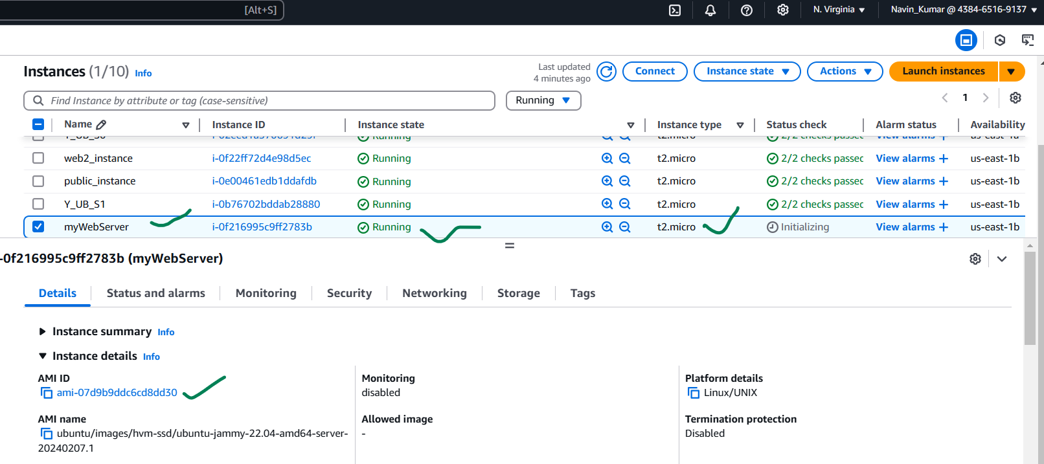
Provision your first infrastructure using Terraform in AWS

